Slide 1
DATA QUALITY / MARKETING OPERATIONS
Marketing Data
Health Monitor
A data quality monitoring application for identifying, prioritizing, and investigating issues in B2B marketing records.
Portfolio project | Python • SQL Server • Streamlit • Plotly
Synthetic dataset — independently developed

Slide 2
01 / BUSINESS PROBLEM
Marketing decisions depend on trustworthy data
Incomplete, duplicated, or inconsistent records can undermine everyday marketing operations.
DATA COMPLETENESS — Missing fields: Key contact and campaign attributes may be absent.
DATA VALIDITY — Invalid values: Malformed email addresses can affect outreach readiness.
DATA CONSISTENCY — Duplicate / variant records: Repeated contacts and inconsistent company names complicate segmentation.
Project objective: Build a practical workflow that surfaces data quality issues, makes them measurable, and helps an operator decide which records need attention first.
02

Slide 3
02 / DATASET
A controlled dataset with realistic quality issues
Synthetic B2B marketing lead data was generated for demonstration; it does not contain SAP or customer data.
TOTAL RECORDS:
ATTRIBUTES:
FLAGGED RECORDS:
AVERAGE SCORE:
2,050
14
410
95.72
— 2,000 base records + 50 duplicate-row copies
— Contact, company, campaign, region, lifecycle and consent fields
— Records identified for review
— Illustrative project scoring logic
Issues intentionally introduced: missing values, invalid emails, duplicate records, and company-name variants.
The dataset supports repeatable testing of validation logic and dashboard behavior.
Quality scores and severity labels are project-defined indicators, not external or SAP standards.
03

Slide 4
03 / TECHNICAL APPROACH
A repeatable pipeline from raw records to review
Implemented in the application
The workflow separates source data, validation logic, database storage, and the operator-facing interface.
01
02
03
04
05
GENERATE
VALIDATE
STORE
MONITOR
INVESTIGATE
— Synthetic CSV data
— Python + Pandas checks
— SQL Server tables + view
— Streamlit + Plotly
— Record-level findings
Design principle: Keep validation rules explicit and queryable, then present the results in a workflow that supports both portfolio-level monitoring and record-level investigation.
04

Slide 5
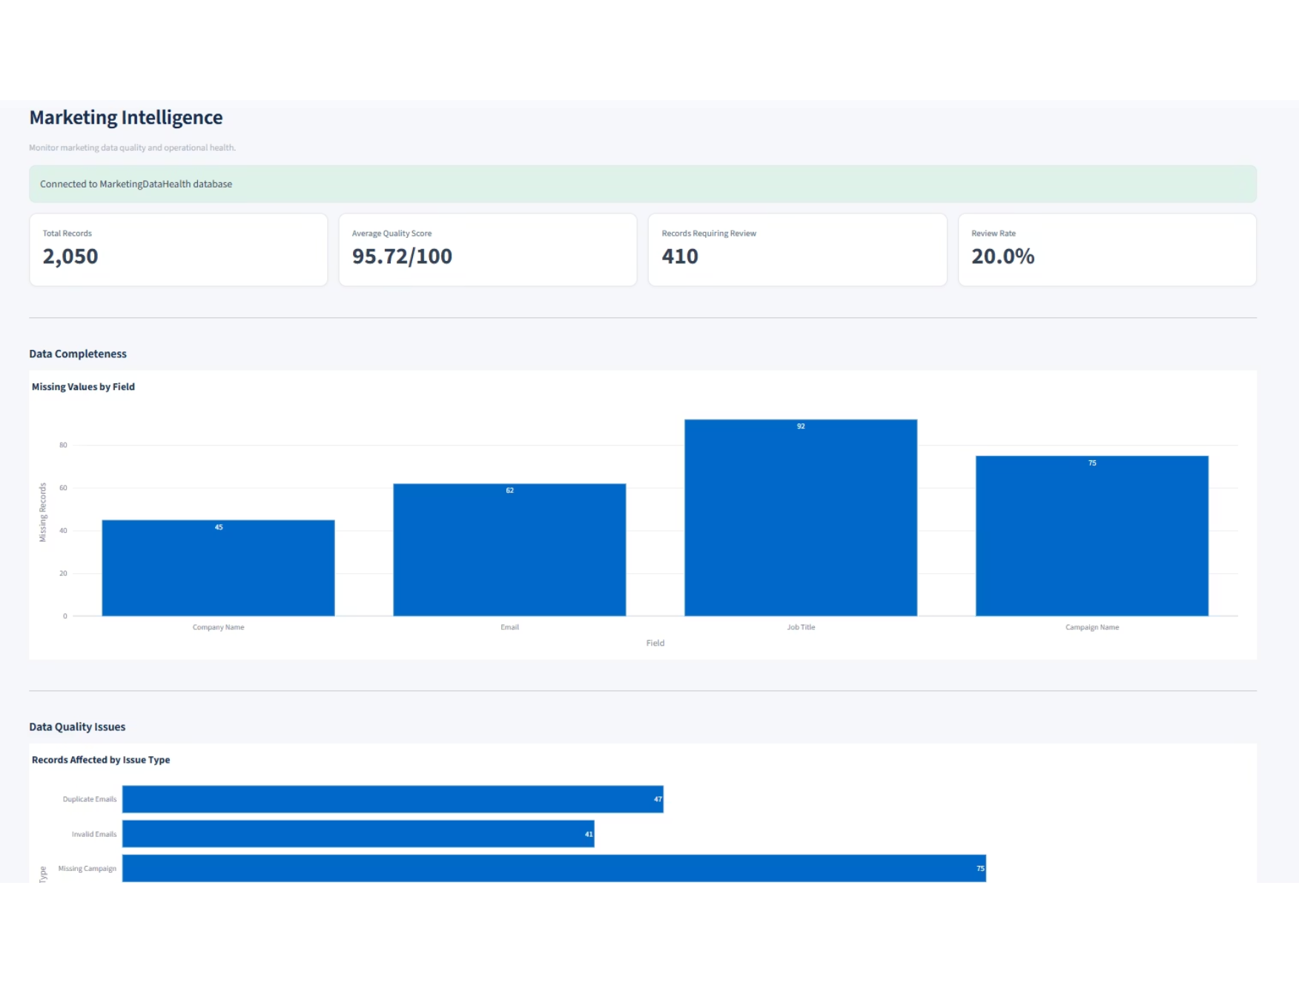
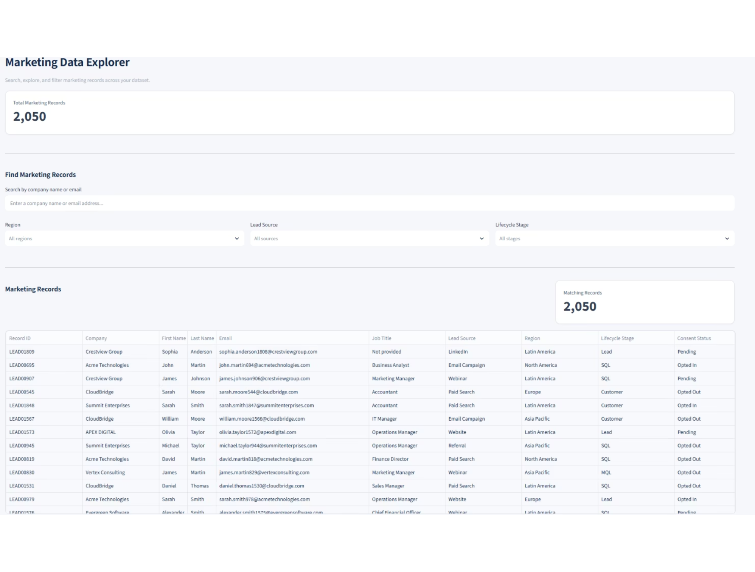
04 / APPLICATION
Monitor the full dataset and explore individual records
Implemented in the application
The overview highlights data health; the explorer lets an operator search and filter the underlying records.
OVERVIEW DASHBOARD
DATA EXPLORER
05

Slide 6
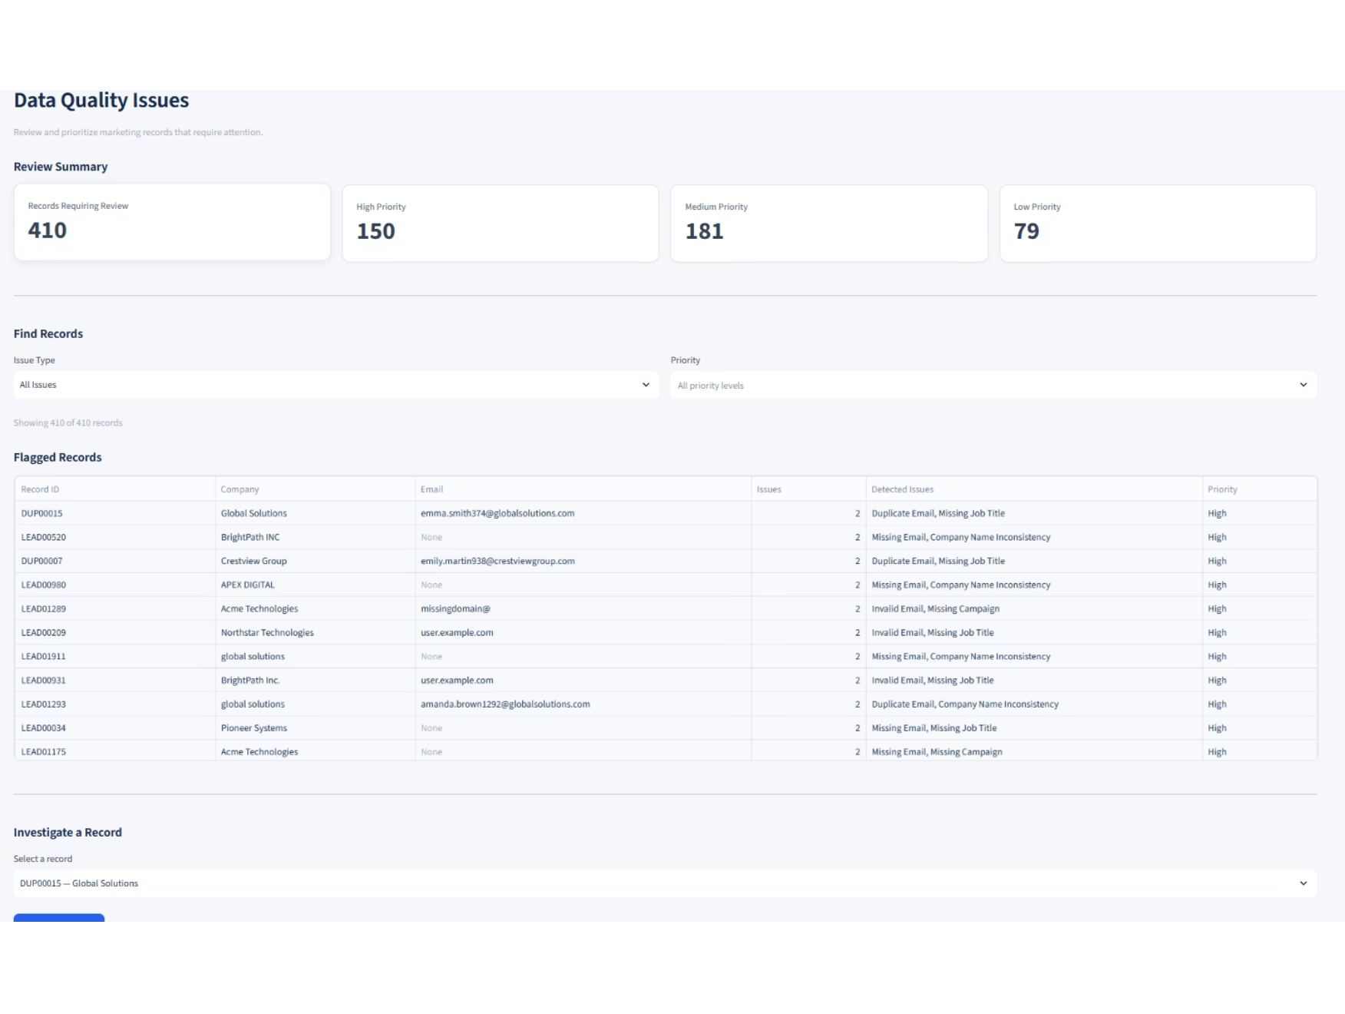
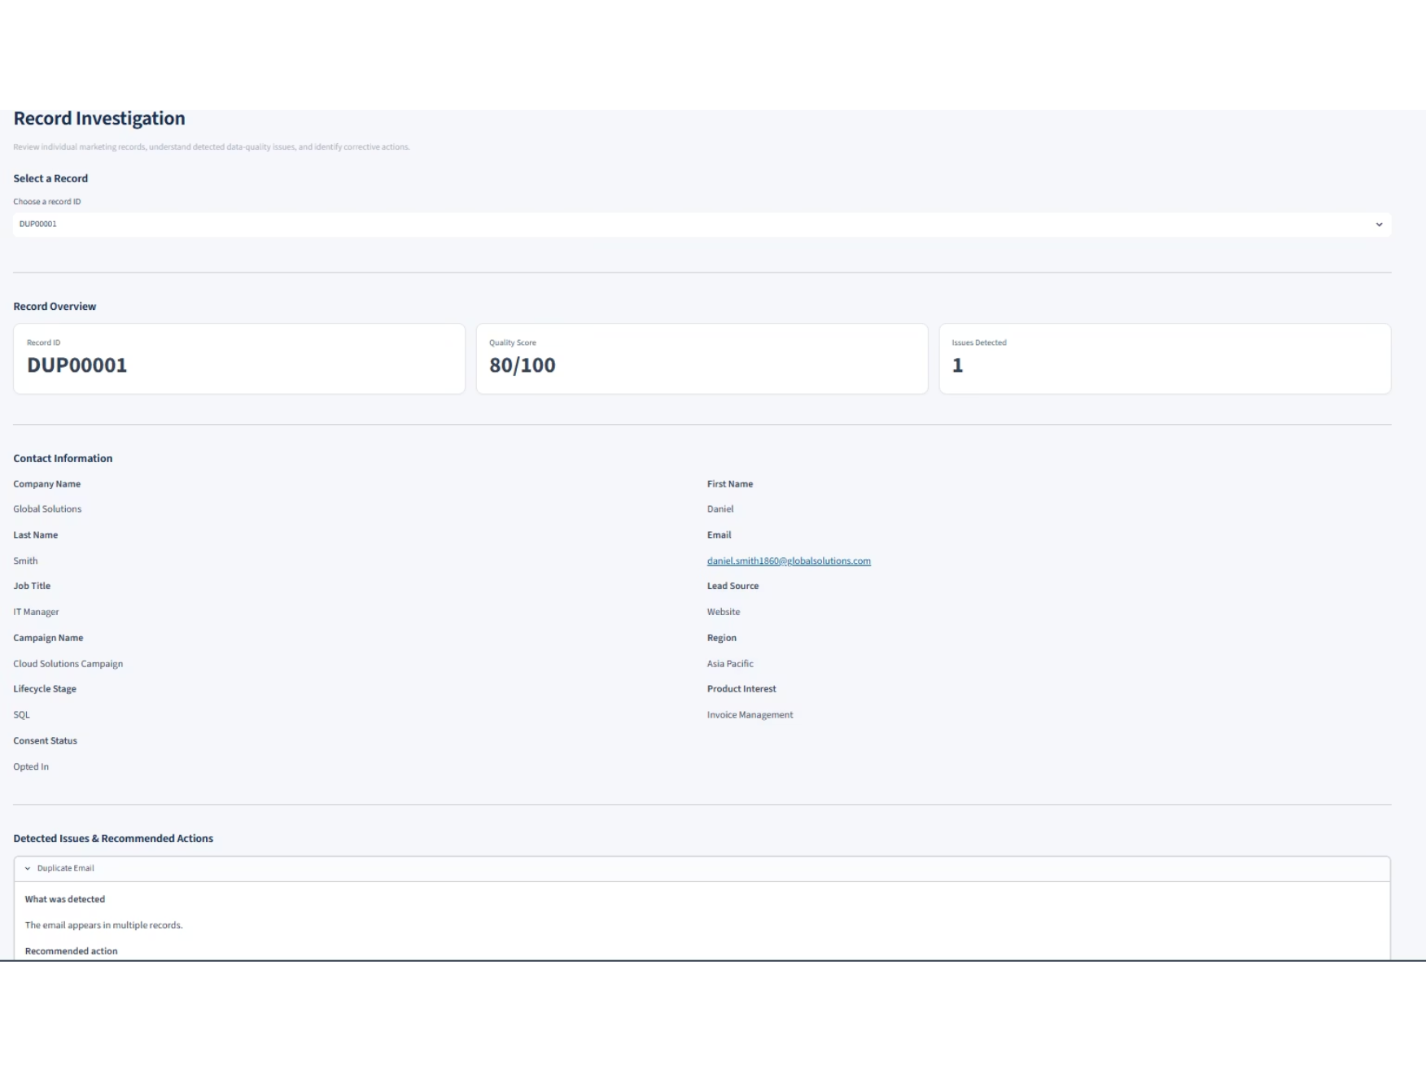
04 / APPLICATION
Prioritize issues and investigate individual records
Implemented in the application
The review queue surfaces records requiring attention; investigation explains the detected issue and suggests a next action.
DATA QUALITY ISSUES
RECORD INVESTIGATION
06

Slide 7
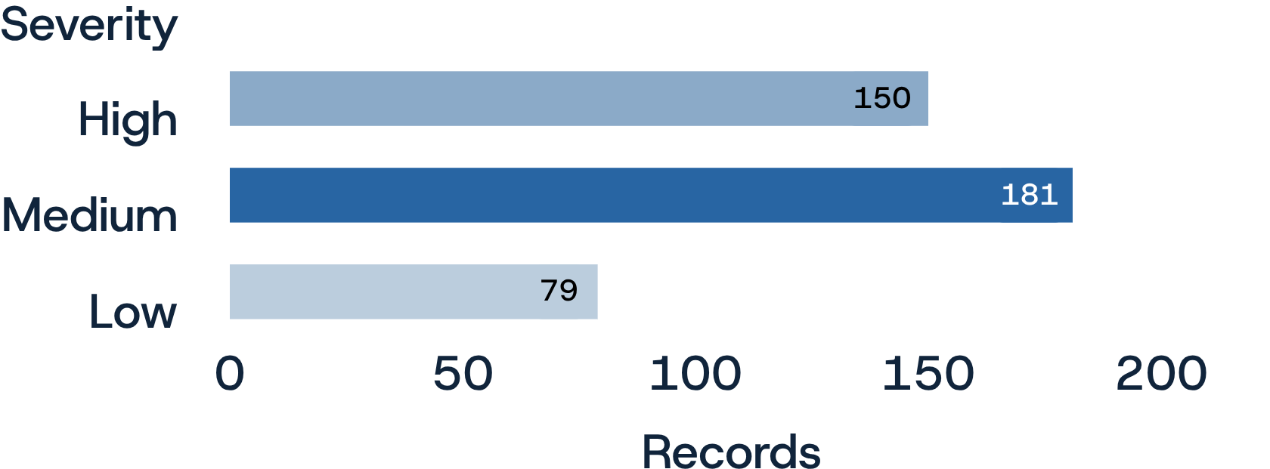
05 / FINDINGS
The monitor identified 410 records requiring review
Implemented in the application
Counts below reflect the current synthetic dataset and the implemented validation rules.
MISSING EMAIL:
INVALID EMAIL:
DUPLICATE EMAIL:
COMPANY NAME INCONSISTENCIES:
62
41
47
77
— 3.02% of all records
— Flagged invalid email records
— Valid duplicate email records
— Rows flagged as inconsistent
Review severity (record-level)
Severity is assigned using the highest-priority issue on each flagged record:
High — email and duplicate issues
Medium — company and campaign issues
Low — missing job title
Severity definitions are illustrative project rules.
07

Slide 8
06 / PROPOSED GOVERNANCE
Turn detection into consistent data stewardship
Proposed recommendation — not implemented
These are recommendations for a future operating model—not policies implemented in the application or statements of SAP policy.
RETENTION — Define retention periods by data purpose and record type; review inactive records on a scheduled cadence.
DEDUPLICATION — Establish matching keys, normalization rules, and a review path before merging potential duplicates.
CONSENT — Make consent status visible and define ownership for validating and updating preference records.
MASS DELETION — Use approval, scope validation, audit logging, and post-action checks for bulk deletion workflows.
08

Slide 9
07 / OPERATIONAL RECOMMENDATIONS
Make data quality actionable—not just measurable
Proposed recommendation — not implemented
A lightweight operating rhythm can help teams move from issue visibility to resolution.
Assign an owner and target resolution path for each high-priority issue category.
01
Review quality trends regularly and investigate recurring sources of defects.
02
Document definitions for key fields, validation rules, and severity levels.
03
Communicate findings in plain language: what is affected, why it matters, and what action is needed.
04
Track issue resolution over time to understand whether data quality is improving.
05
09

Slide 10
08 / POTENTIAL BUSINESS VALUE
Reliable records support more confident marketing operations
Potential value
The project demonstrates a workflow that could help teams prioritize data hygiene and communicate quality risks.
VISIBILITY — Shared view: A consistent picture of data health across the dataset.
PRIORITIZATION — Focused review: Issue categories and severity help direct attention.
TRACEABILITY — Record context: Operators can inspect why a record was flagged.
Potential downstream relevance: Cleaner, more consistent marketing data can support segmentation, campaign execution, customer engagement, and more trusted reporting.
Built with Python, SQL Server, Streamlit & Plotly.
10

